Slide 1

Sort, Search & Filter
Rare book Store phase 2

Slide 2
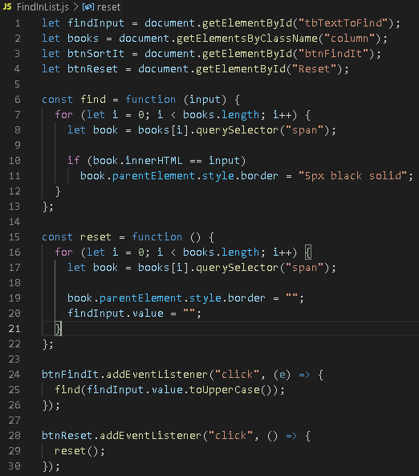
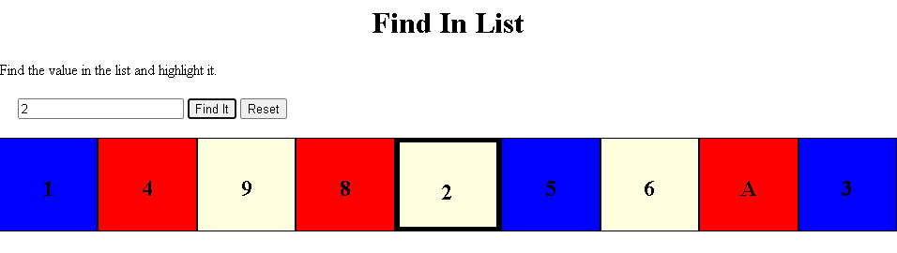
find-in-list

Slide 3
1. Used getElementById/getElementsByClassName to get the HTML Collection that contained each div in the row, to select the buttons to and the input box 2. Iterated that the HTML collection using the for loop 3. To find the div that the user wants highlight, I used an if statement. To highlight the div, I put a black border around it 4. To reset, I set the border style and input box to empty strings
Find-in-list

Slide 4
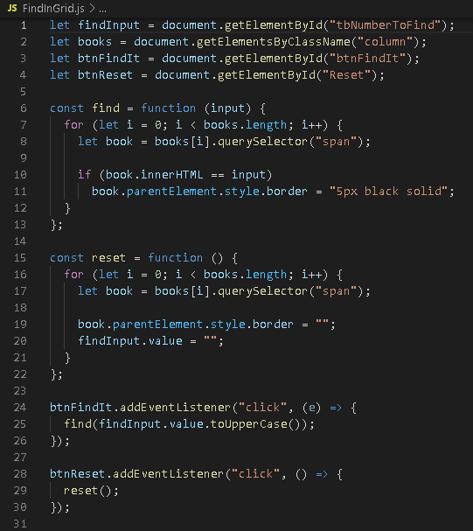
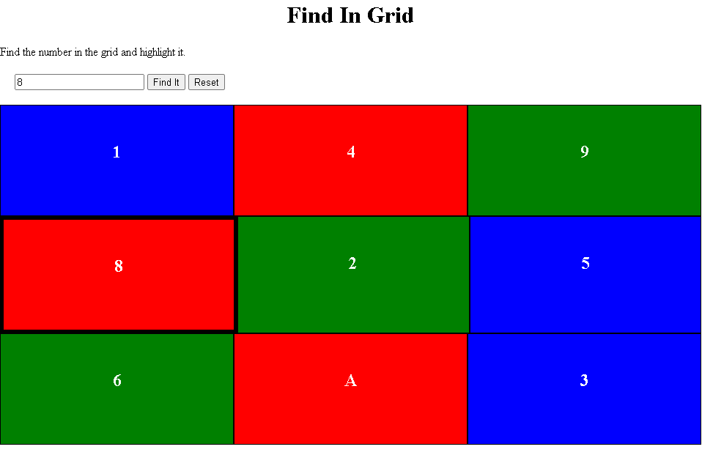
find-in-grid

Slide 5
1. The code is similar to that of the Find-In-List grid
Find-in-Grid

Slide 6
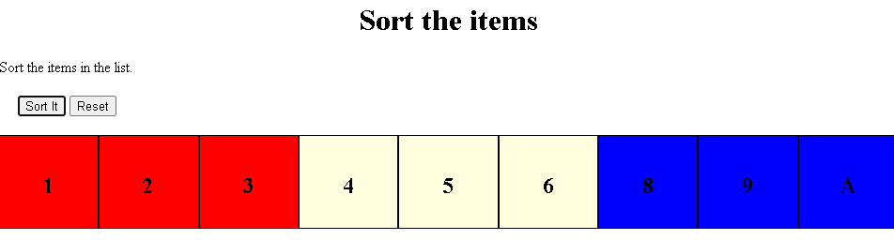
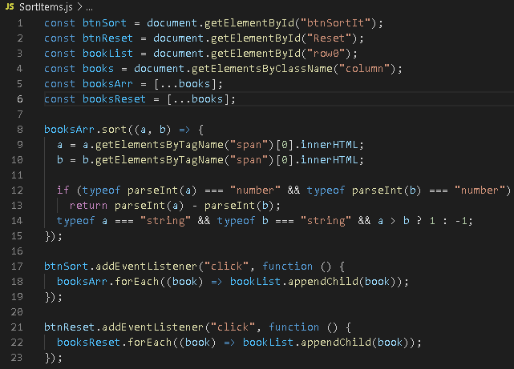
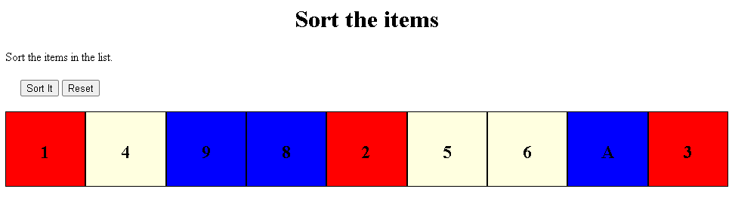
Sort
Reset
Sort-items

Slide 7
1. Used getElementById/getElementsByClassName to get the HTML Collection that contained each div in the row, to select the buttons and the input box. Created two variables and set them to the HTMLCollection. I needed one for the sorting and one for the reset. 2.With this problem I decided to use the sort method. In order to use the sort method, I had to turn the HTML collection into an array. Hence why I used the spread operator. 3.To get the value in each element of the array, I used getElementByTagName.
Sort-items

Slide 8
4. Decided to sort the number first because the letters will automatically go to the end of the array 5. In order to use the a-b algorithm, I first had to change the a & b variables from strings to numbers. So I used parseInt(). 6. Verified that a and b are numbers. If a and b are both numbers, it will put the numbers in order and iterate to the next pair of numbers. 7. The next line of code (line 14) is for the iterate through pairs of letters. (to test it, I added divs to the html file)
Sort-items

Slide 9
8. Since the sort method, mutates the original array, the array was already updated with the correct order. 9. I updated the row by looping through the array (using forEach) and appending each element to the row in order 10. Since the original array was mutated, I created a copy of the original HTML Collection and turned it into an array. Then use the forEach method to append the original array to the row
Sort-items

Slide 10
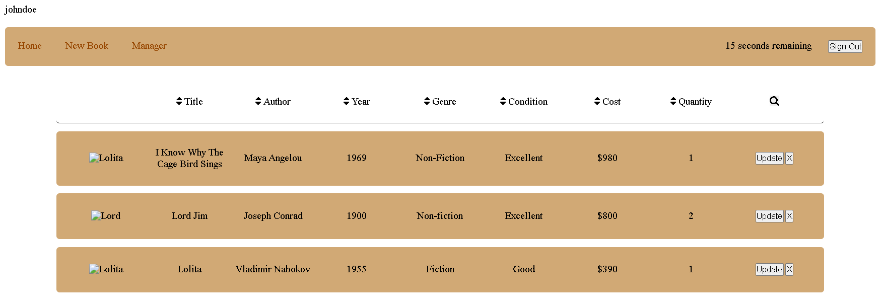
Book-list

Slide 11
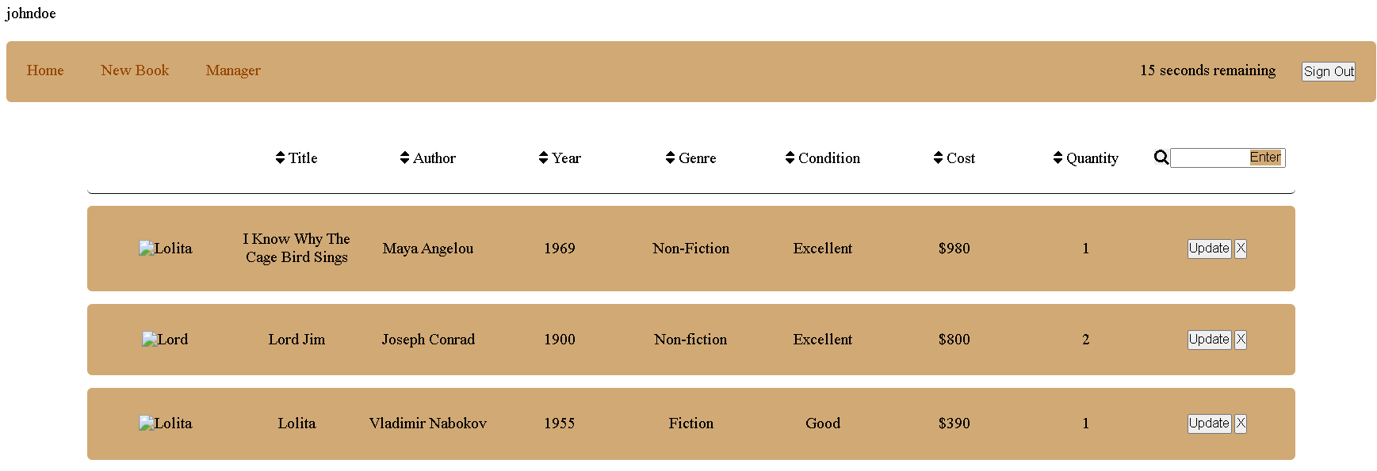
Book-list

Slide 12
1. The user will be able to search by clicking the Search icon. 2. The search icon will open the input field in order to type the book that is being looked for 3. When the user clicks enter, the input field will close and the book that the user is searching for will be the only book to appear 4. Also, if the user did not want to search at the moment, the user just can click the icon again and the input field will go away 5. Users will be able to search by price, authors & title
Search
Book-list

Slide 13
1. The user will just simply click on the sorting icon or name of how they want to sort the book list 2. I figured that this is the cleanest and gives the user more sorting options 3. The user will be able to sort by any field on the table
Sort
Book-list

Slide 14
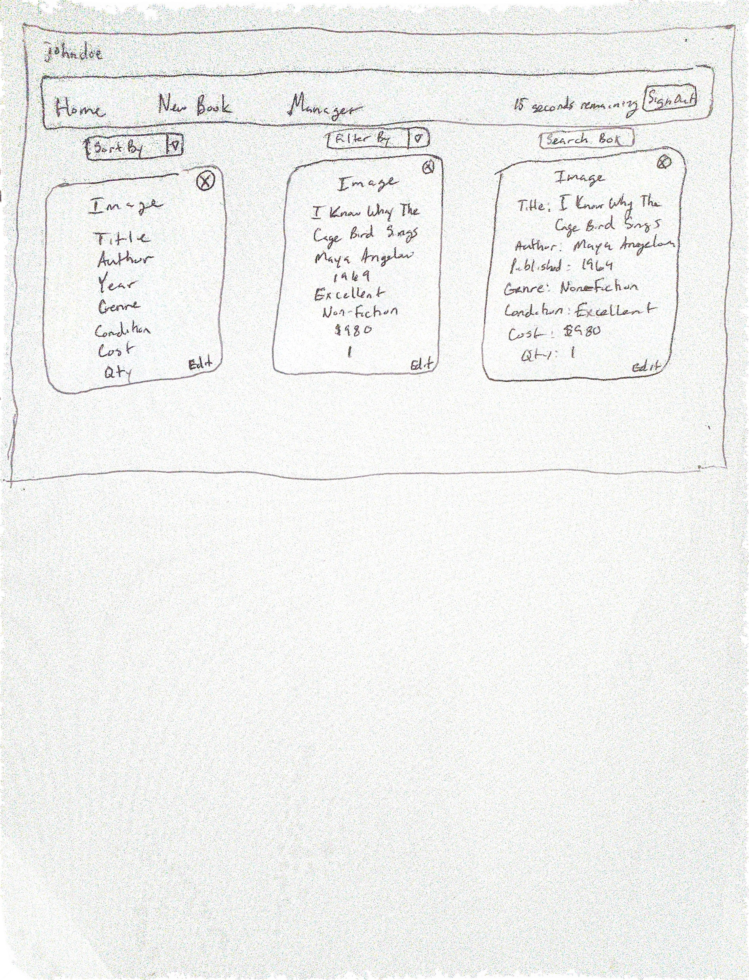
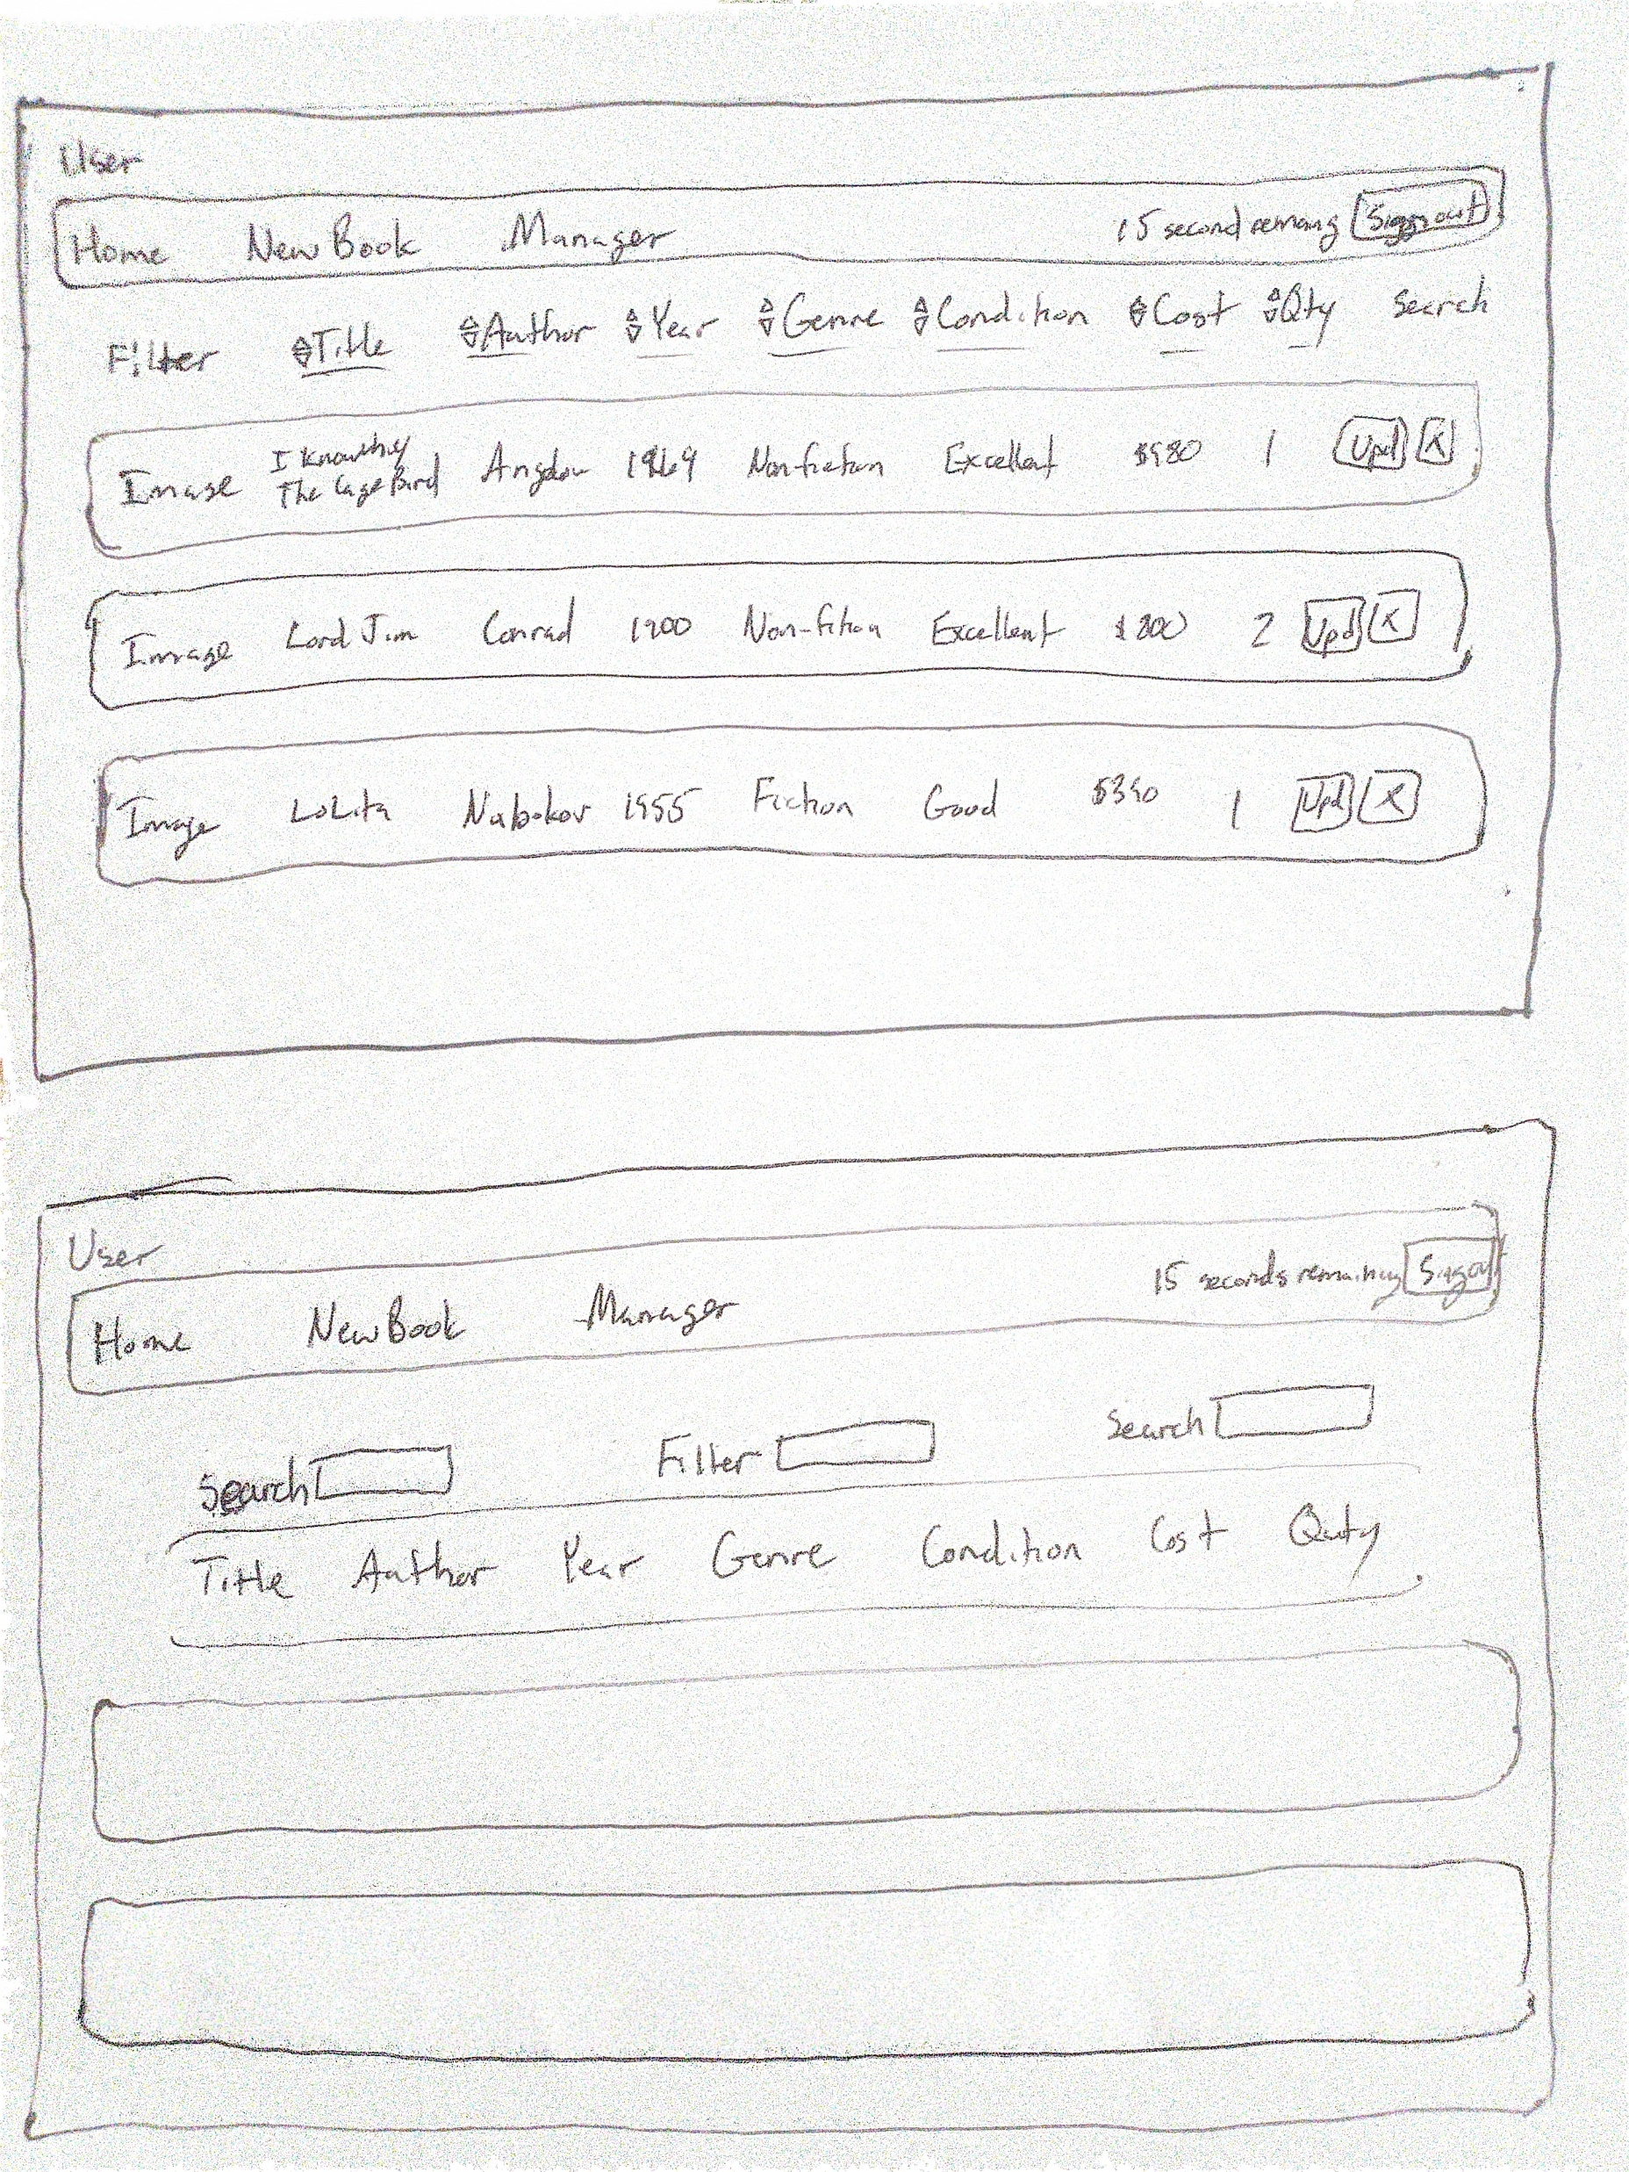
Prototype Drawing
Book-list

